Slide 1

Maverick Bank System
A Scalable & Modular Banking Application
Presented by: Yash Sudhakar Jadhav

Slide 2

Problem Statement
Most traditional banking systems suffer from poor modularity, weak API structure, and lack secure and scalable architecture for core operations like transactions, account handling, and loan processing.
Goal: Build a robust app that supports banking operations with REST APIs and clean architecture.

Slide 3
Project Objectives
Develop a RESTful backend system to handle core banking operations
Implement modular architecture using Spring Boot
Ensure scalability, maintainability, and ease of integration
Use open APIs for testing with Swagger UI
Prepare system for future role-based access and security (JWT)

Slide 4
Technology Stack
Programming Language: Java 17
Framework: Spring Boot
ORM: Spring Data JPA (Hibernate)
Database: MySQL
Build Tool: Maven
API Testing & Docs: Swagger UI, Postman
Framework :Angular (v15+)
Development Tools : VS Code, Angular CLI

Slide 5
System Architecture (Backend)
Layered Architecture:
1
Controller Layer
Handles HTTP requests
2
Service Layer
Business logic
3
Repository Layer
Data access
4
Entity Layer
Models for DB mapping
5
DTO Layer
Separates API and internal models
6
Configuration Layer
Application setup, Swagger, etc.

Slide 6
System Architecture (Frontend)
Layered Architecture:
1
Component Layer
UI + logic (HTML, TS, SCSS)
2
Service Layer
Handles API calls using HttpClient
3
Routing Layer
Manages navigation + guards
4
Model Layer
Interfaces for typed data
5
Guard Layer
Auth & role-based route protection
6
Configuration Layer
Project setup and settings

Slide 7

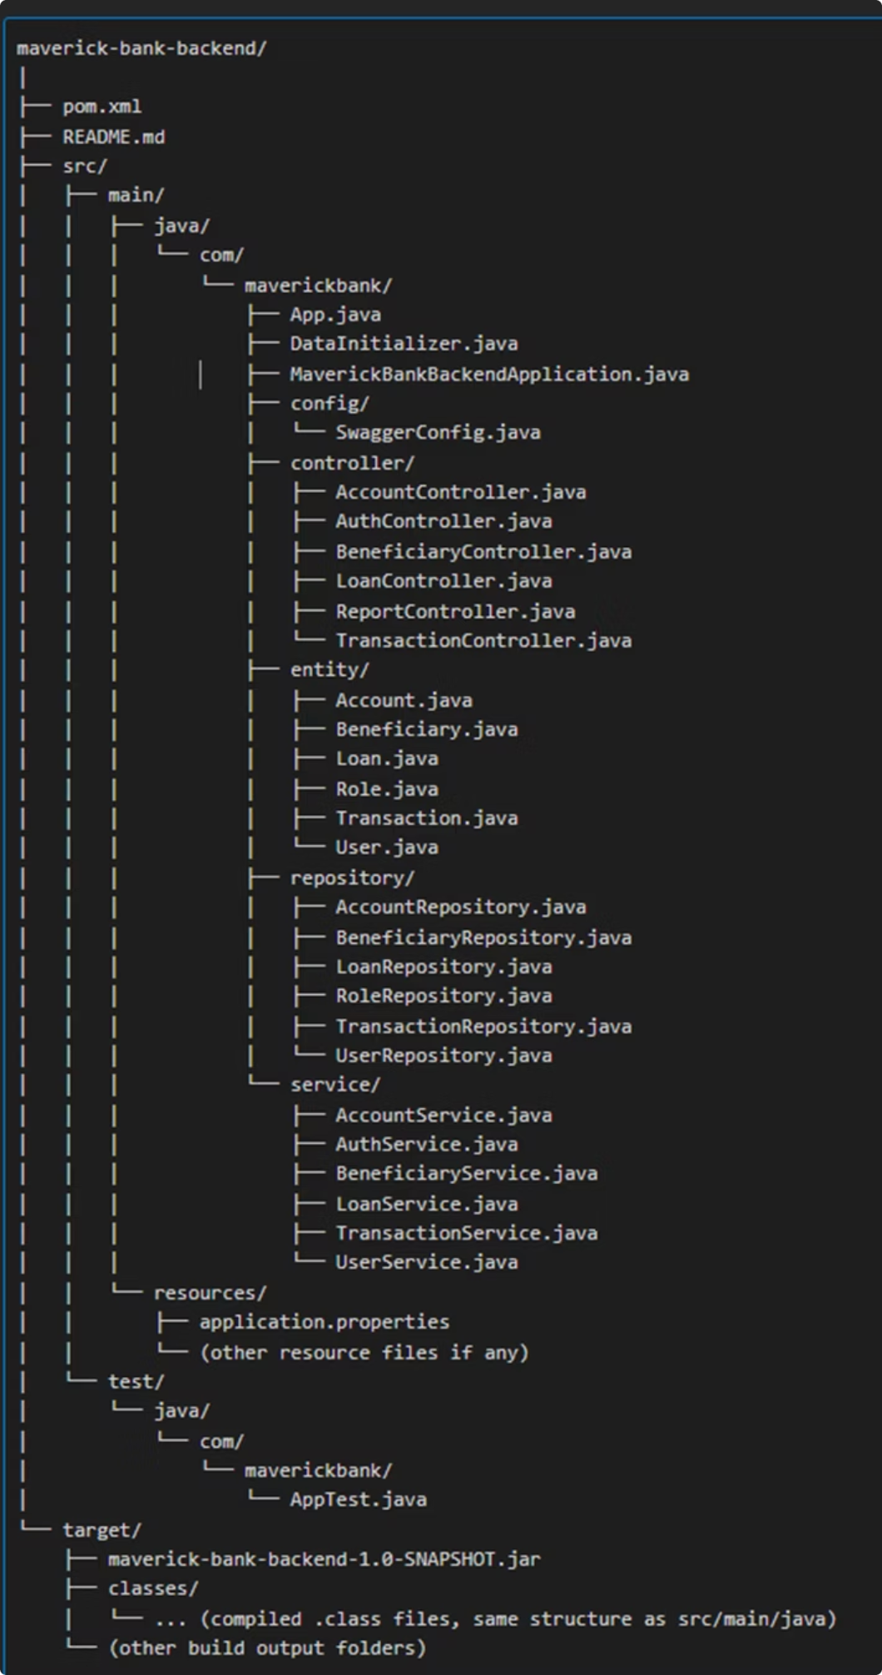
Folder Structure
BACKEND

Slide 8

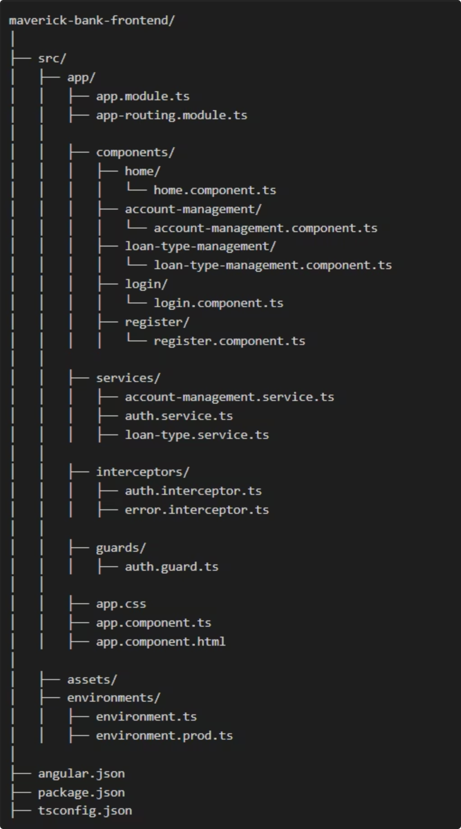
Folder Structure
FRONTEND

Slide 9
Modules Overview (Backend)
User & Role Management
Account Module
Create, view, manage accounts
Transaction Module
Loan Module
Deposit, Withdraw, Transfer
Apply, View, Update Loan Status
Beneficiary Module
Reporting Module
Add, View Beneficiaries
Account statement, transaction history

Slide 10
Modules Overview (Frontend)
DashboardComponent
AccountManagementComponent
Admin/Customer dashboards
List & approve accounts
CustomerAccountRequestComponent
LoanComponent
Submit new account requests
Apply/approve/reject loans
TransactionComponent Module
BeneficiariesComponent Module
View and perform transactions
Add/manage beneficiaries
ReportsComponent
Services for API communication
View transaction and user reports

Slide 11

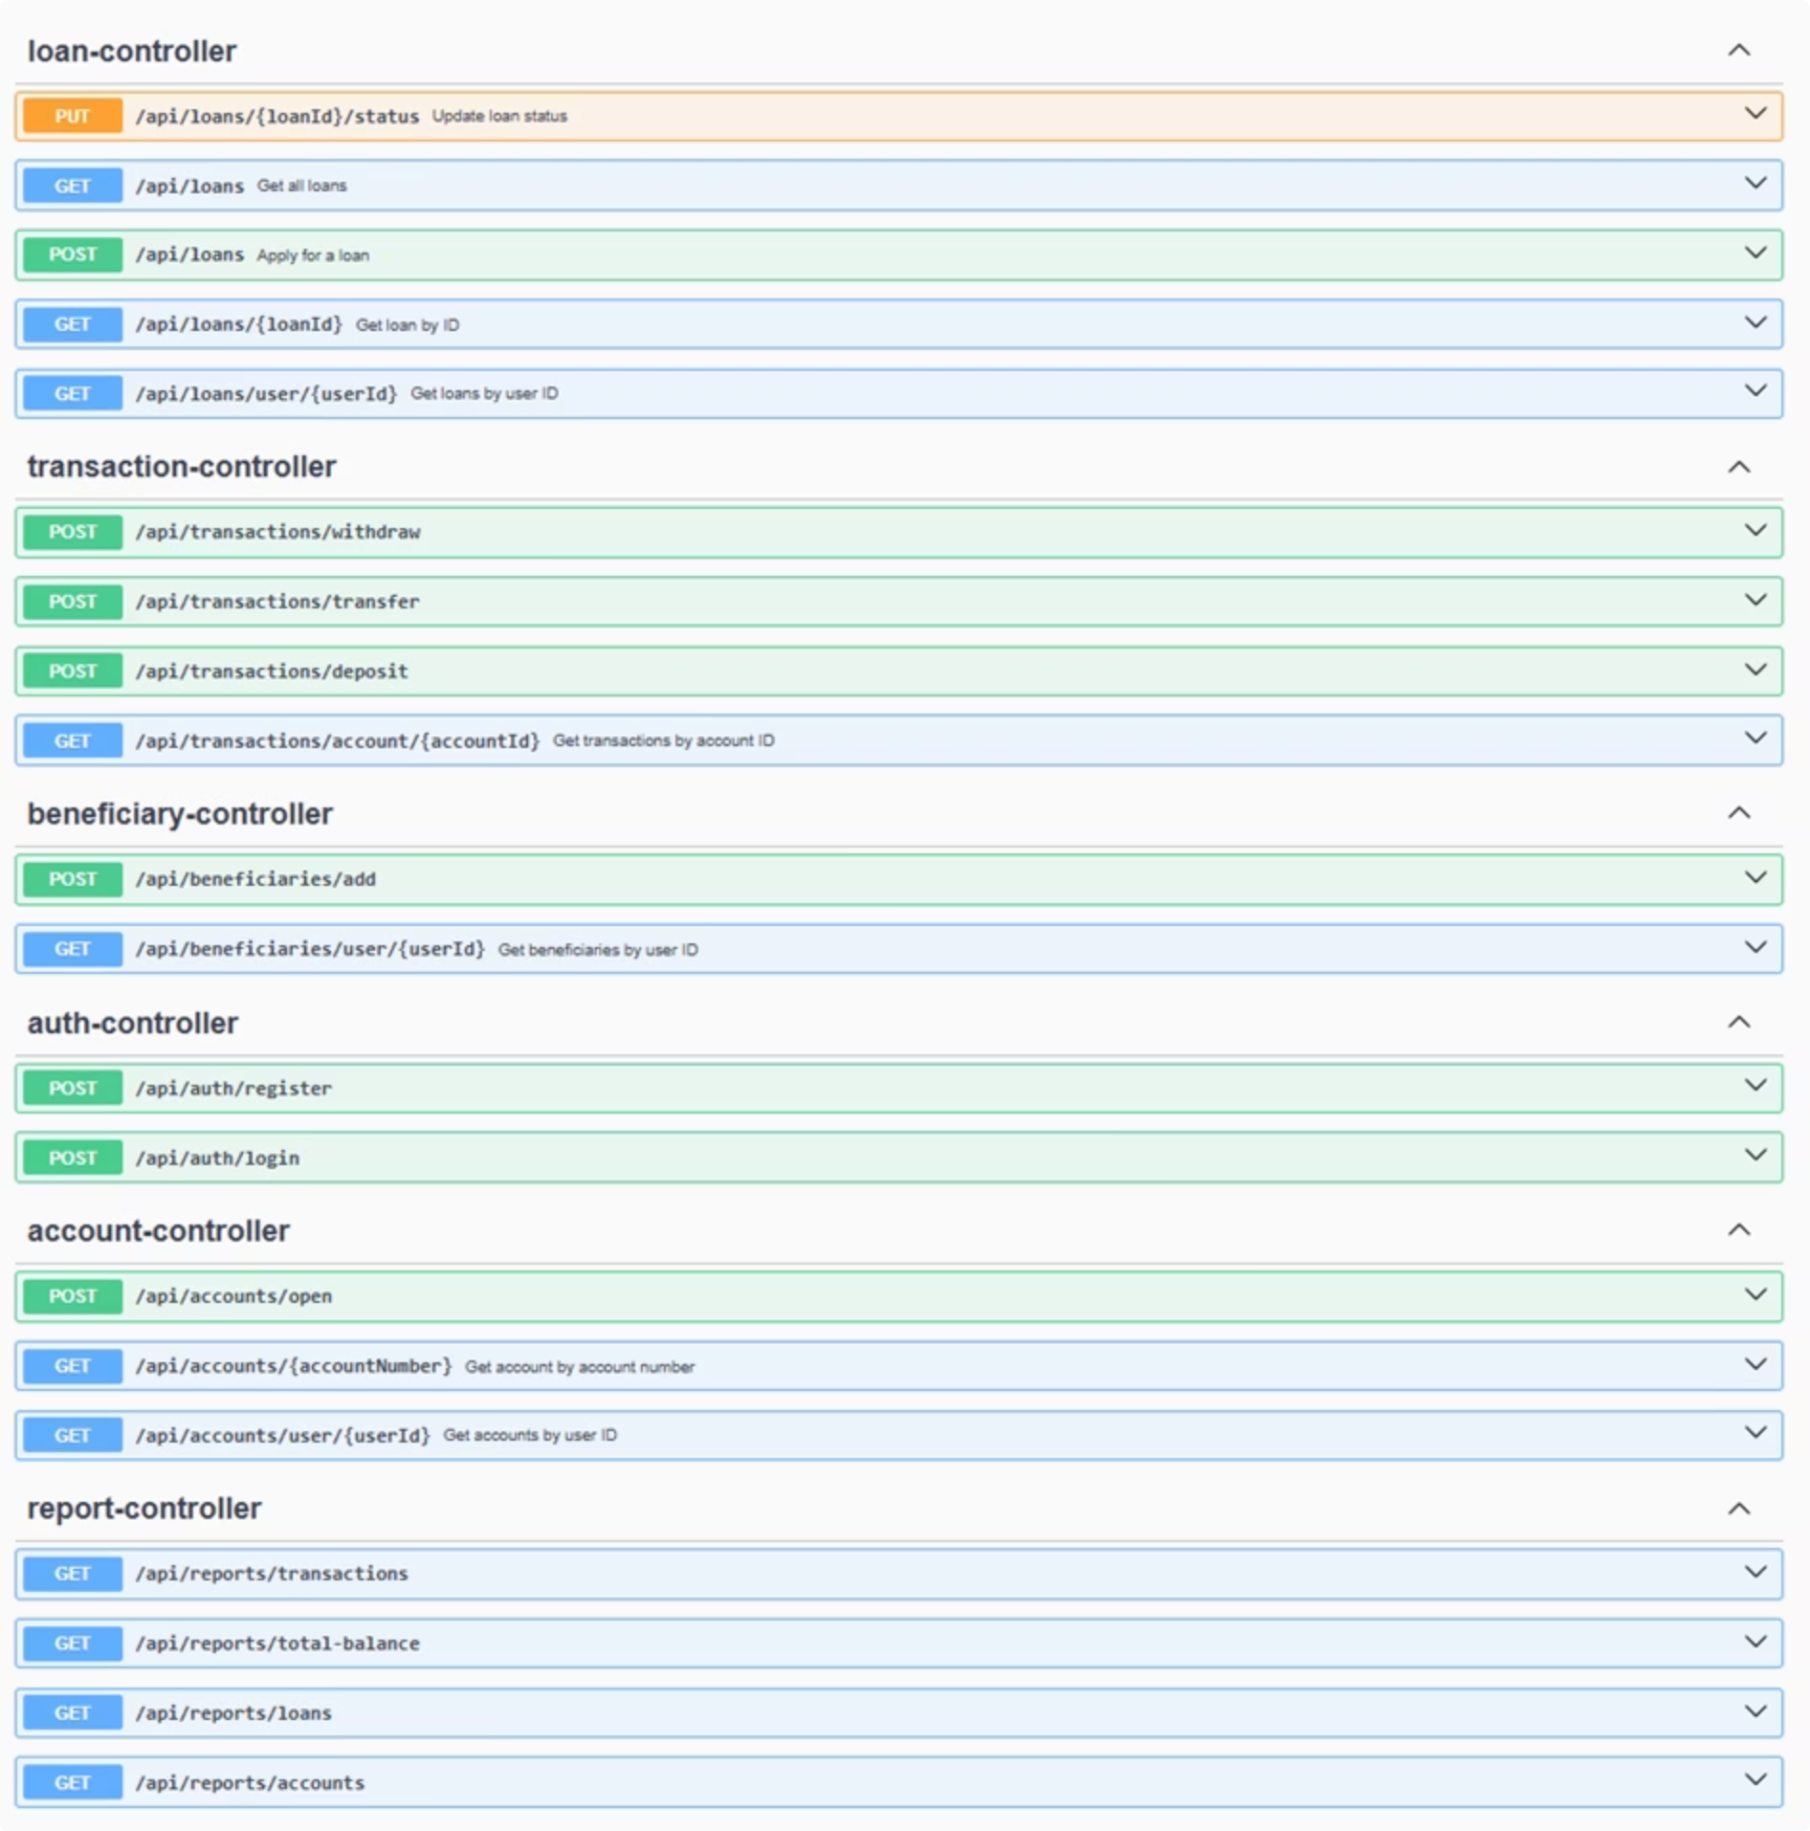
API Endpoints Overview
Swagger UI

Slide 12
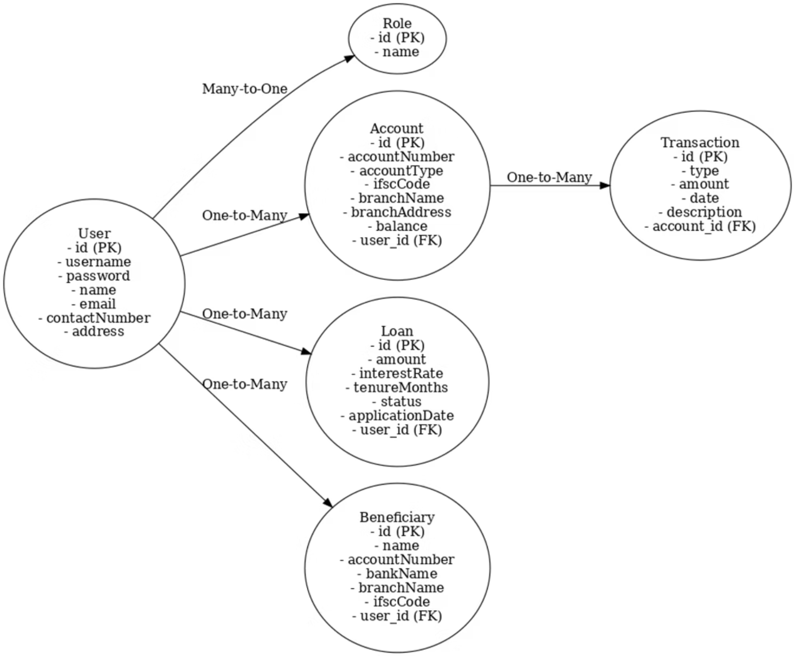
Database Design
Main Entities:
User, Role, Account, Transaction, Loan, Beneficiary
Key Relationships:
User 1—* Account
Account 1—* Transaction
User 1—* Loan
User 1—* Beneficiary
User — Role

Slide 13
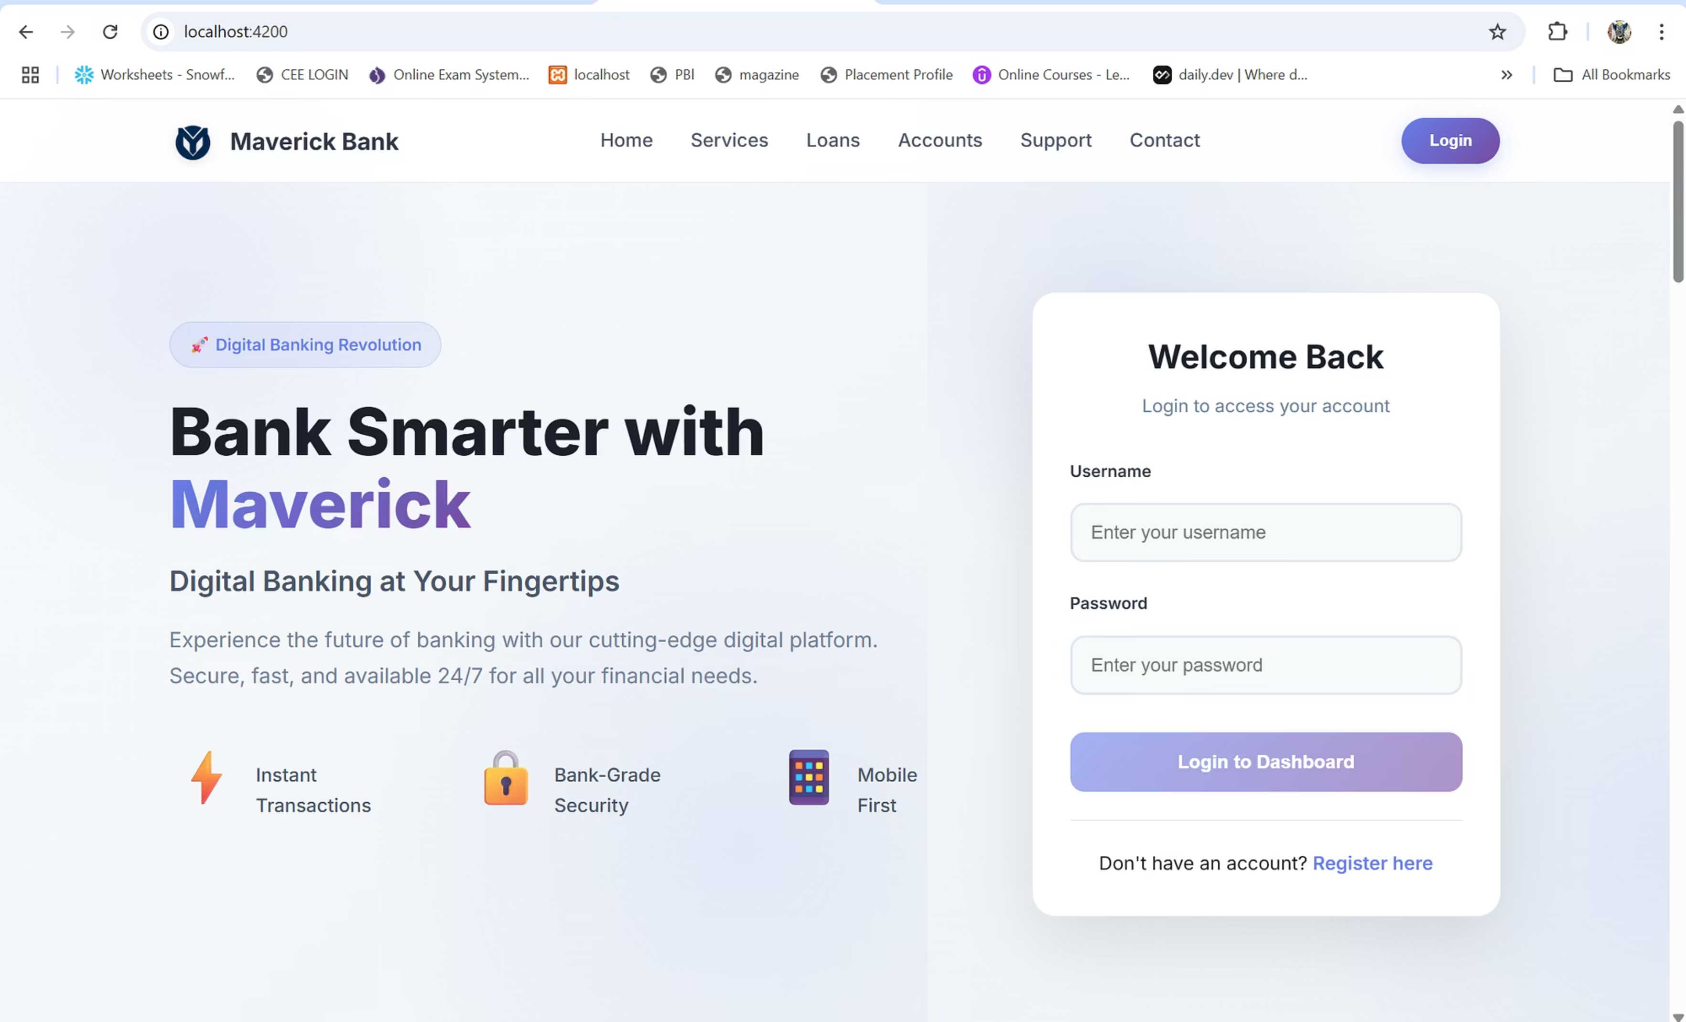
Home UI

Slide 14
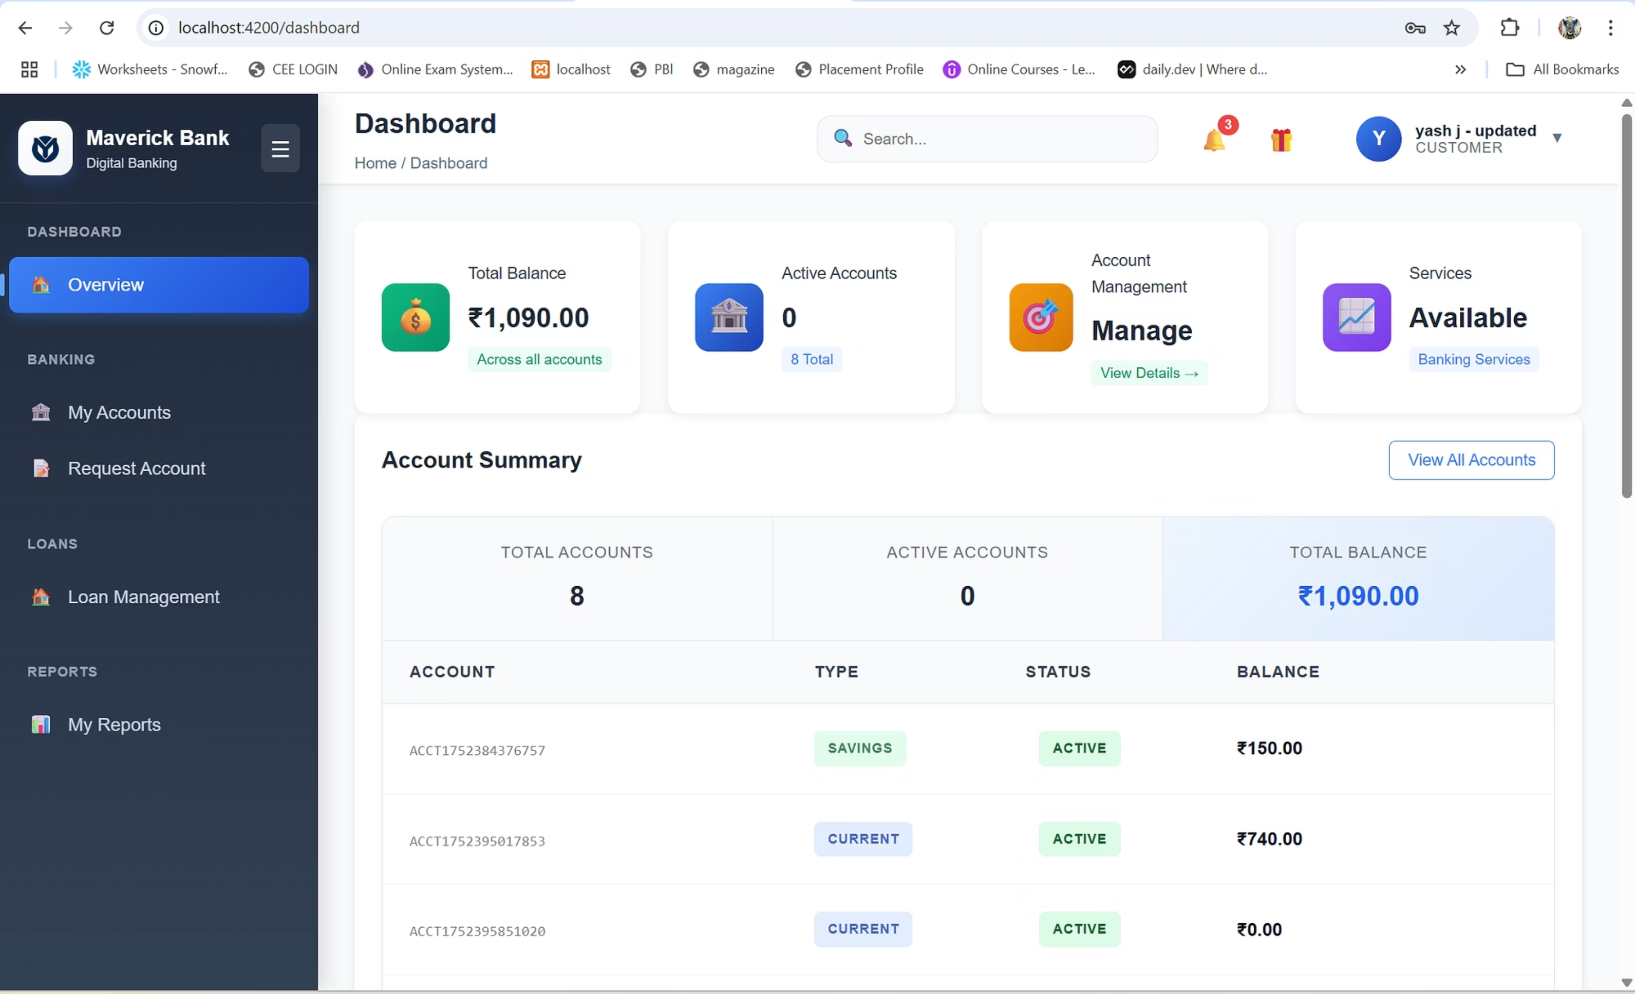
CUSTOMER Dashboard

Slide 15
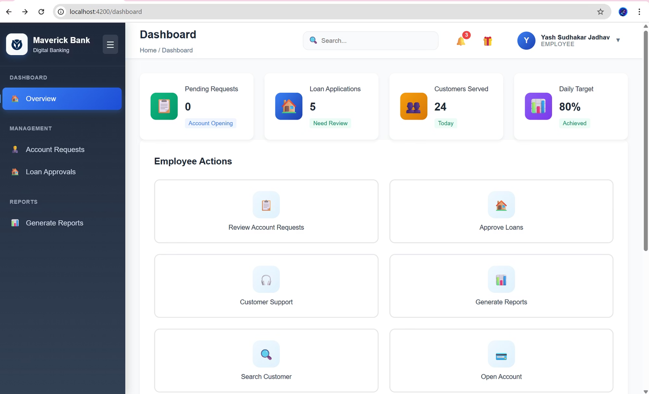
EMPLOYEE Dashboard

Slide 16
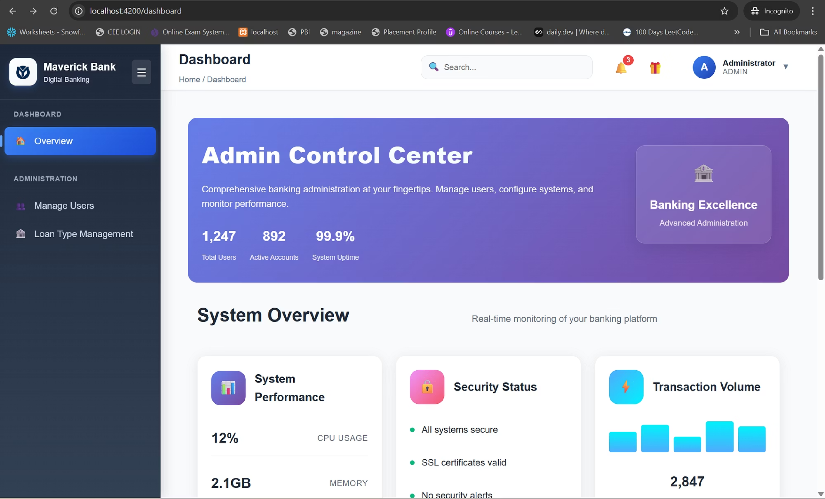
ADMIN Dashboard

Slide 17
Authentication & Authorization (Planned)
Currently open APIs (for demo/testing)
JWT-based login/signup structure available
Roles: CUSTOMER / EMPLOYEE / ADMIN
Access control ready via annotations

Slide 18
Testing & Documentation
Unit & Integration Testing using JUnit & Spring Boot Test
API tested with Swagger UI and Postman
Structured JSON error messages
Test coverage on service and controller layers
Example error response format shown

Slide 19
Future Enhancements
Enable JWT login & registration APIs
Add CI/CD pipeline using GitHub Actions
Containerize with Docker
Add Admin dashboards and frontend integration
Advanced reporting module with charts

Slide 20






Full Flow of a Feature (e.g., Account Request)
User Input
Submits form on UI via customer-account-request.component.ts
HTTP Request
Triggered through account.service.ts
API Call
Received by AccountController.java (Spring Boot)
Business Logic
Processed in AccountService.java
Database Call
Data accessed via AccountRepository.java (JPA)
Data Storage
Securely stored in account table (MySQL)

Slide 21




Key Features
Responsive Design
API Tested
Swagger Integrated
Utilises Angular Material for a seamless user experience across devices.
Robustly tested using Postman to ensure reliable and consistent performance.
Comprehensive API documentation provided through Swagger UI for easy understanding.
Proxy Setup
Layered Backend
Configured in Angular for efficient and secure API communication.
Structured and modular MVC architecture for enhanced maintainability and scalability.

Slide 22
Thank You
📧 ​yashj98819@gmail.com​💻 GitHub: ​https://github.com/maverickbank/system​
"Digital banking, reimagined."

